Slide 1



Online Banking Application
AD bank
Arjun Dhakal
Delara Amiri

Slide 2
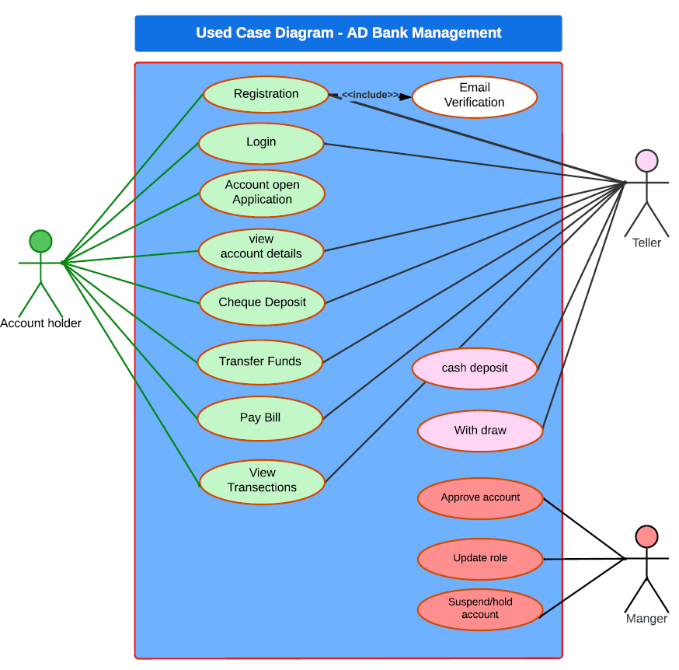
business perspective
Background of the project
Traditional banking problems
Limited accessibility
Longer transaction times
Limited transparency
Lack of options
Limited customer service
Limited technology integration
Security concerns
Lack of innovation
Notes:
Background, high level view
- Background of the project, e.g.
. explain what was the purpose of system
you were implementing and what problem does it solve.
. you're NOT talking about your particular solution.
. You're talking about the class of solutions.
. You can talk about business perspective on this one slide only.

Slide 3





The Problems that were solved
REDUCED PAPER WASTE
BETTER FINANCIAL PLANNIN
24/7 ACCESS.
INCREASED SECURITY
FASTER TRANSACTIONS
MOBILE BANKING
EASIER BILL PAYMENTS
CONVENIENT ACCOUNT MANAGEMEN
REDUCED FEES
ENHANCED CUSTOMER SERVICE
Notes:
Your solution overview
- show your solution from high level, e.g.
screenshot(s), list main features from
user point of view, features, functionalities.
Say WHAT was implemented BUT NO DETAILS ON HOW.

Slide 4
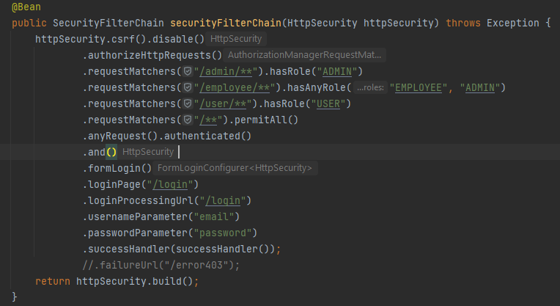
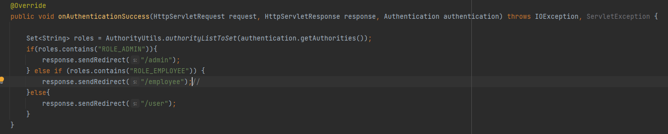
Challenges and solutions
Different roles, different permission , different access level
RBAC(Role-Based Access )
ABAC(Attribute-Based Access)
Middleware
Notes:
One of our first challenges was how to implement different roles with varying permissions and access levels. To address this challenge, we implemented different endpoints for each role, with operations specific to each endpoint.
Overall, implementing different roles with different permissions and access levels is an important step in ensuring the security and integrity of your web application.

Slide 5


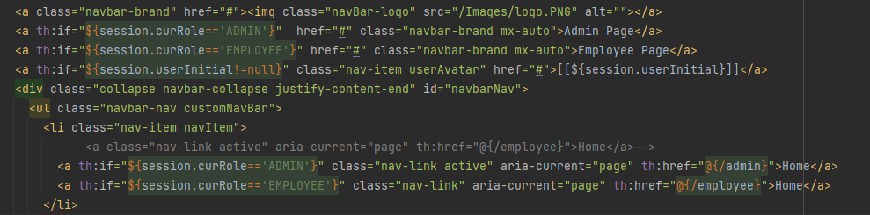
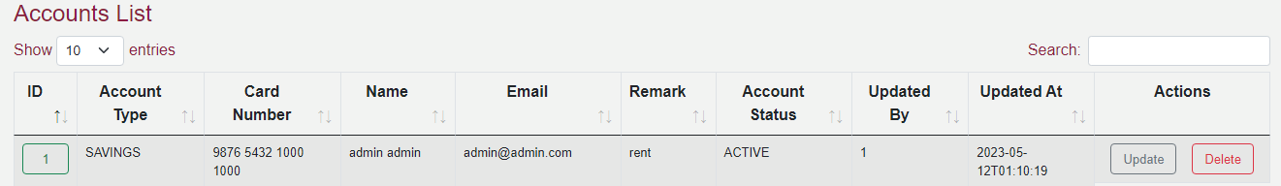
Notes:
Your solution overview
- show your solution from high level, e.g.
screenshot(s), list main features from
user point of view, features, functionalities.
Say WHAT was implemented BUT NO DETAILS ON HOW.

Slide 6
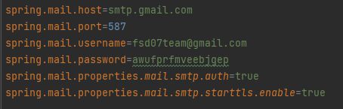
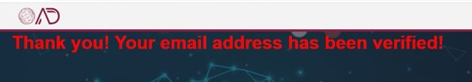
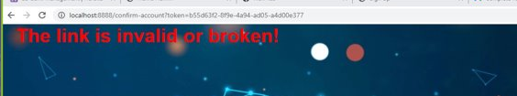
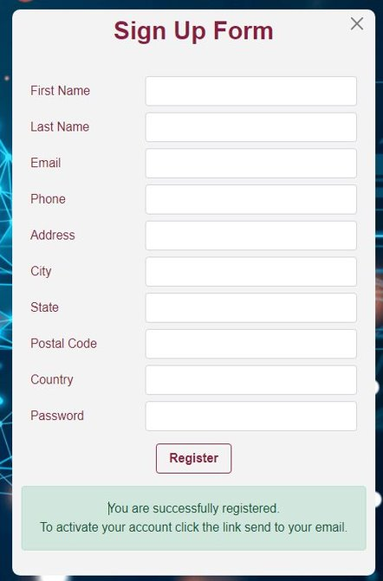
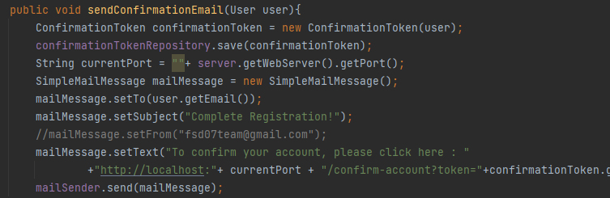
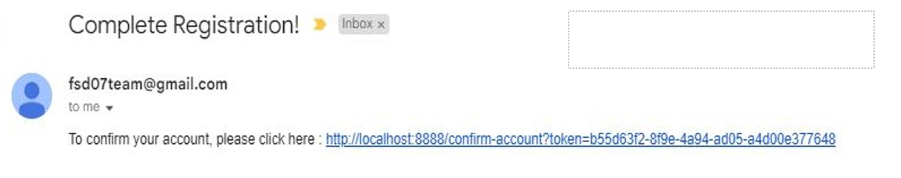
Email Verification
Notes:
4-7 slides: Challenges and solutions
- show database structure here
- talk about each of the interesting technologies you used
and each major problem you had to solve on your own
to make the solution work.

Slide 7
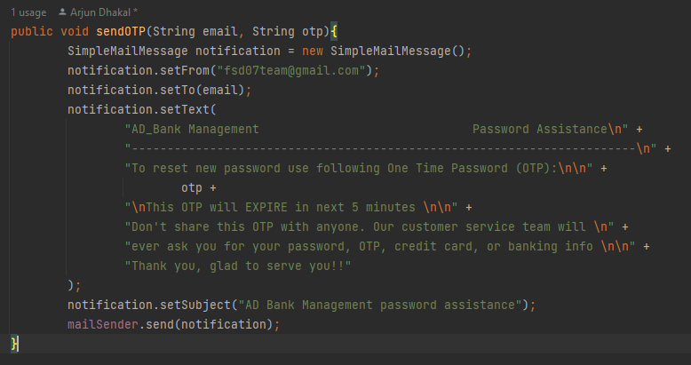
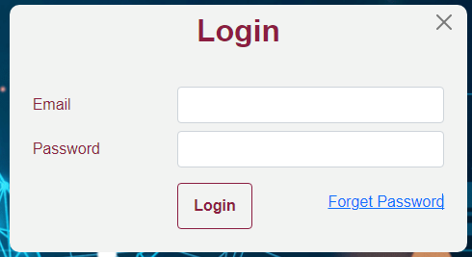
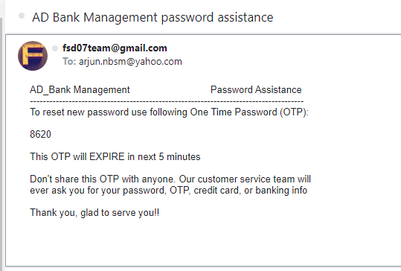
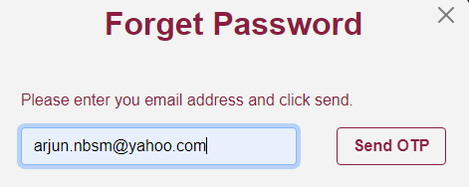
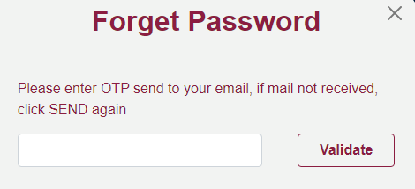
Reset Password
Notes:
4-7 slides: Challenges and solutions
- show database structure here
- talk about each of the interesting technologies you used
and each major problem you had to solve on your own
to make the solution work.

Slide 8
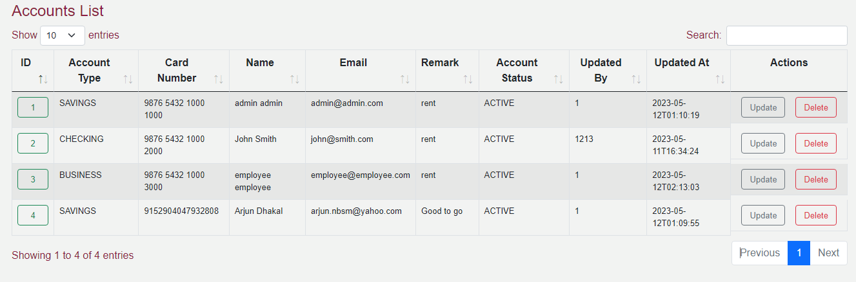
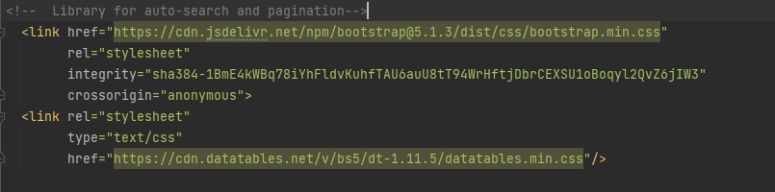
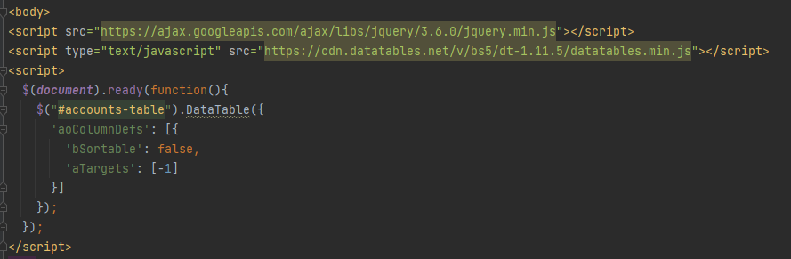
Challenges and solutions

Slide 9

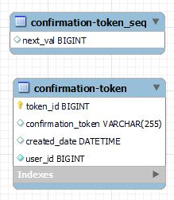
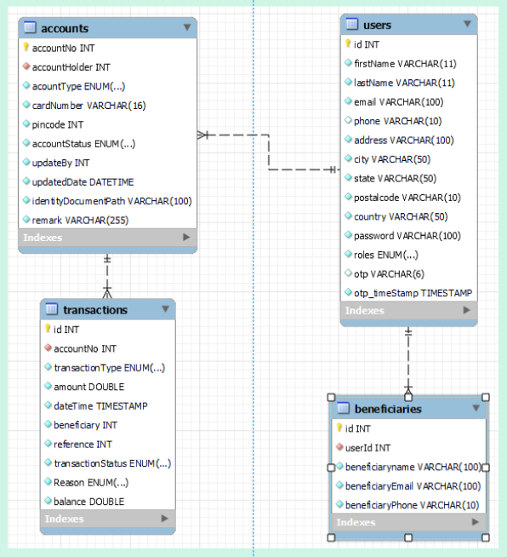
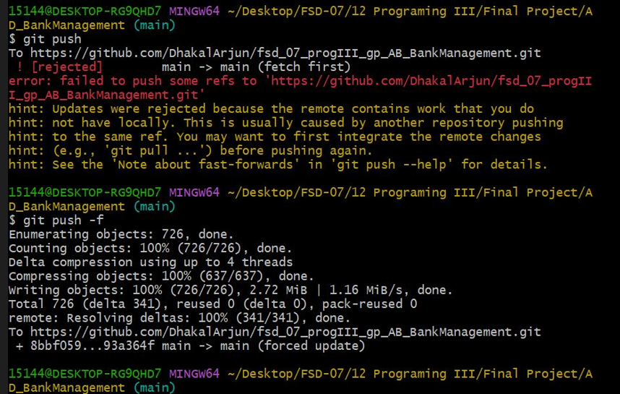
Git Conflict
Data base
Notes:
4-7 slides: Challenges and solutions
- show database structure here
- talk about each of the interesting technologies you used
and each major problem you had to solve on your own
to make the solution work.

Slide 10
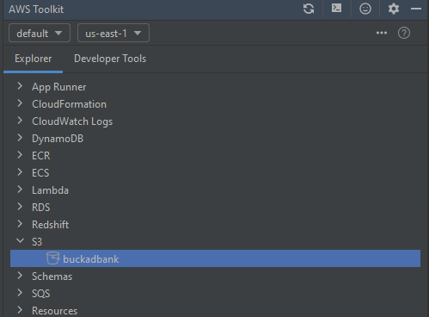

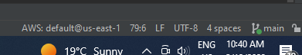
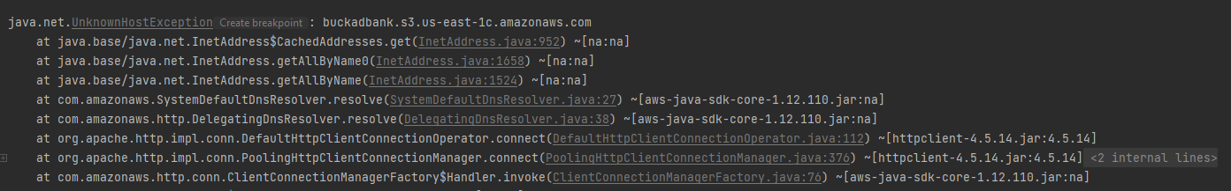
Challenges and solutions
AWS S3
Notes:
S3

Slide 11
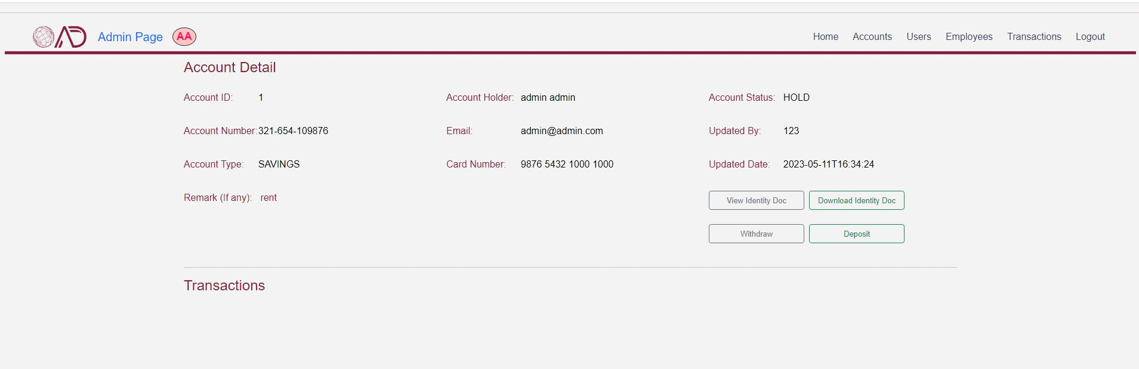
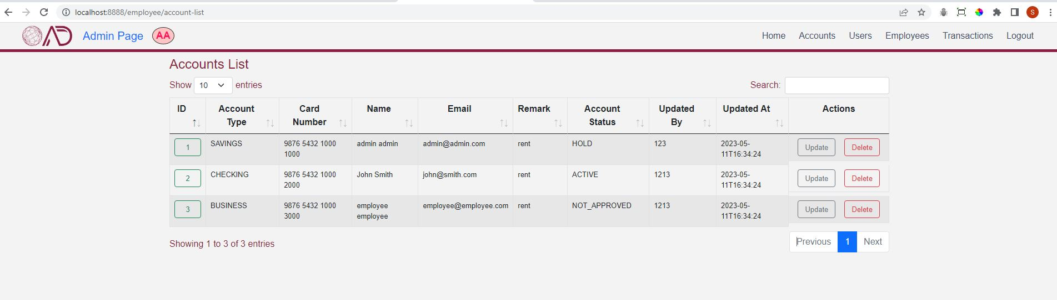
What We learned admin
Soft Delete
Notes:
"Soft delete" refers to a data management practice where data is not permanently deleted from a database, but instead marked as deleted or "soft deleted".
The first button (Delete) is displayed only if the user has not been deleted (i.e., user.isDeleted()==false). If clicked, the button will trigger an HTTP request to a URL specified by the th:href attribute.The second button (Restore) is displayed only if the user has been deleted (i.e., user.isDeleted()==true). If clicked, the button will trigger an HTTP request to a different URL specified by the th:href attribute, which appears to be a RESTful endpoint for "restoring" a deleted user.

Slide 12
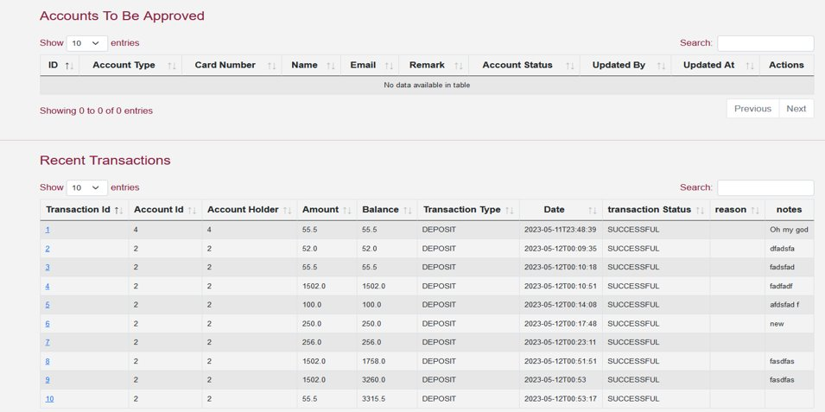
What We learned admin
Paging in a data table
Notes:
Implementing paging in a data table typically involves querying the database for a limited number of records and applying pagination controls to navigate through the results. It may also involve caching data to reduce the number of database queries required.

Slide 13
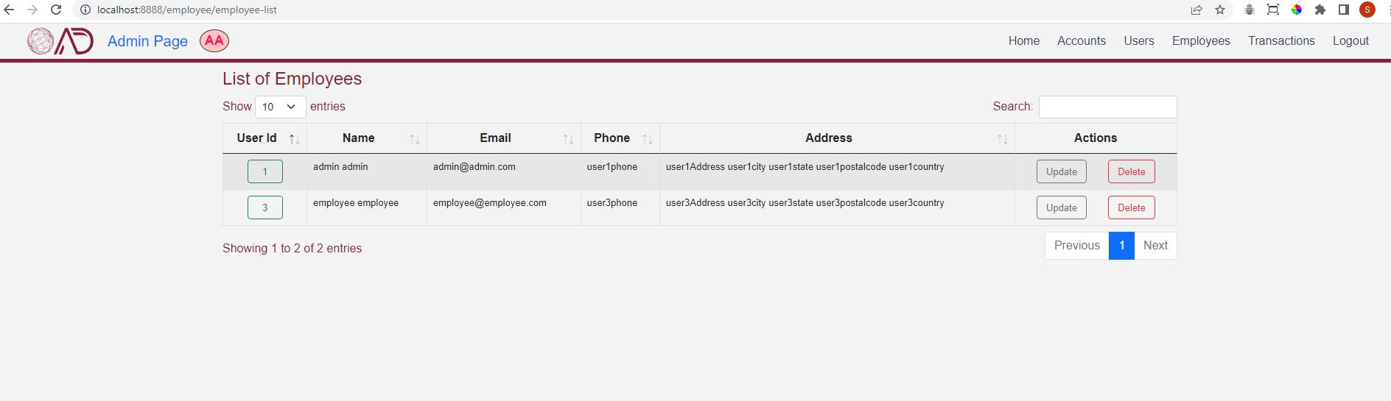
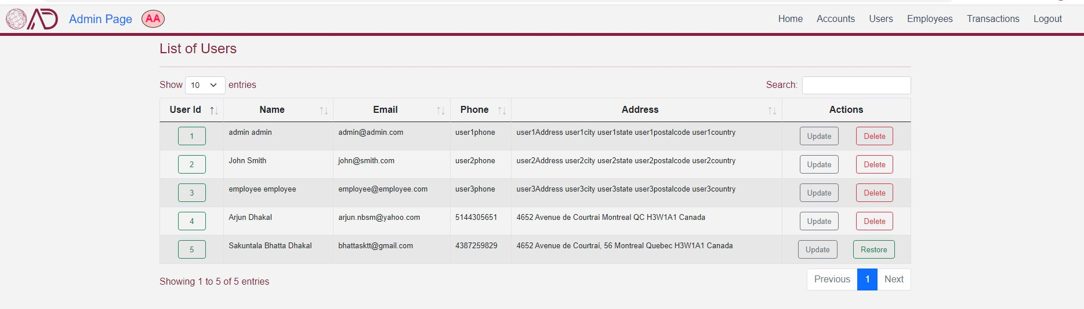
What We learned admin
13
Notes:
"In order to associate an avatar with a user's session, retrieve the user's name and family name from the database when they log in. Then concatenate the first letter of the name with the first letter of the family name to create the avatar."

Slide 14
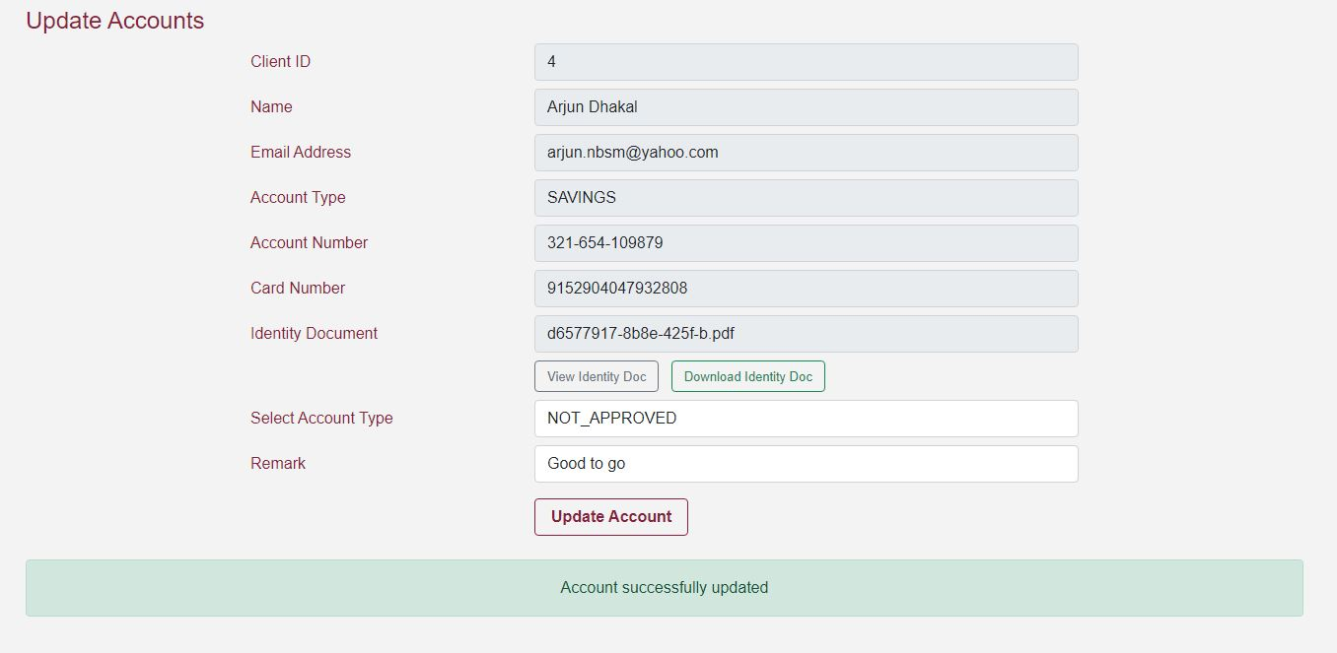
What We learned admin
BindingResult
Notes:
When an object is validated in Spring MVC, any errors or validation failures are stored in a BindingResult object. The BindingResult can be used to check for errors and validation failures, and to retrieve information about the binding process.
BindingResult has several methods to help with error handling, such as hasErrors() to check if there are any errors, getFieldError() to retrieve a specific error for a field, and getGlobalErrors() to retrieve global errors that are not tied to a specific field

Slide 15
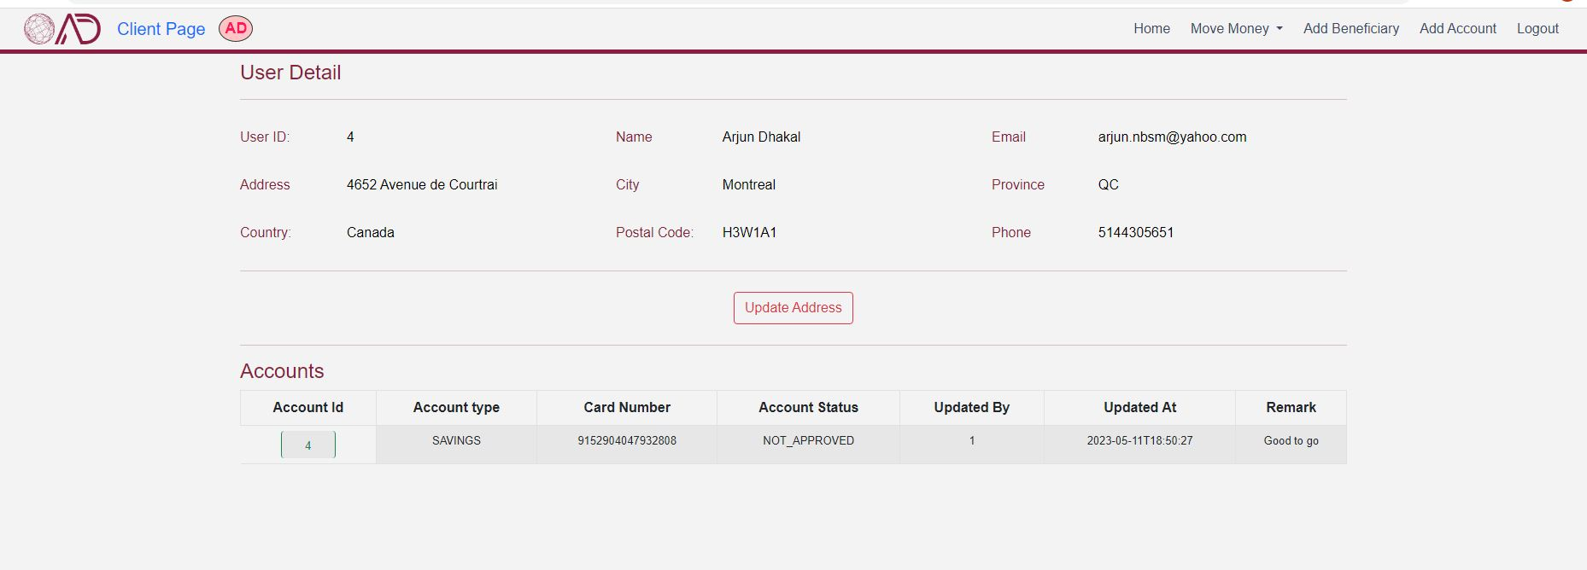
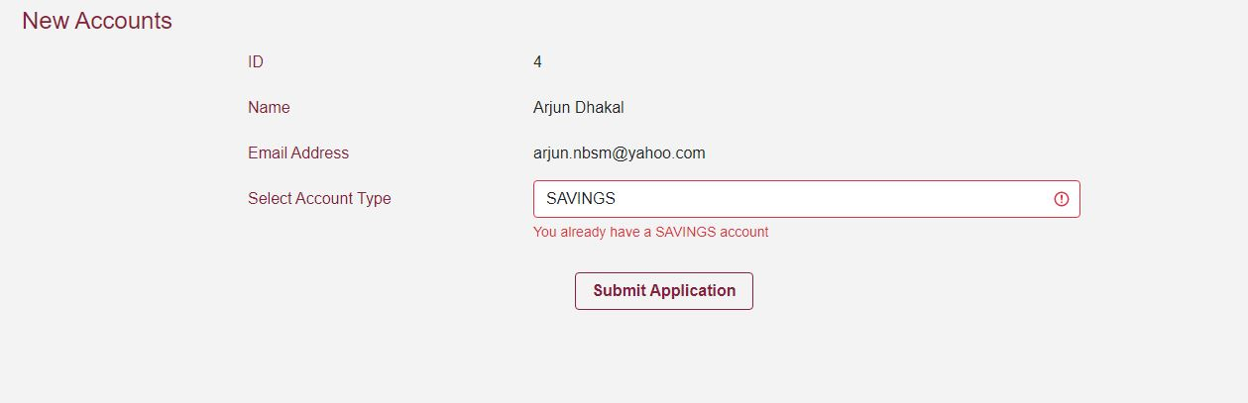
What We learned client
Notes:
From the user's point of view, we limited the update of user information to the address,And each user cannot have more than one user account of any type,
When a user opens a new account, a unique 16-digit card number plus a random three-digit number is generated for her

Slide 16
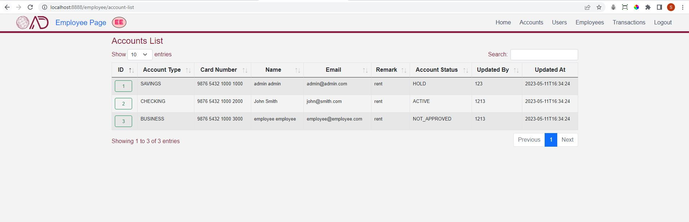
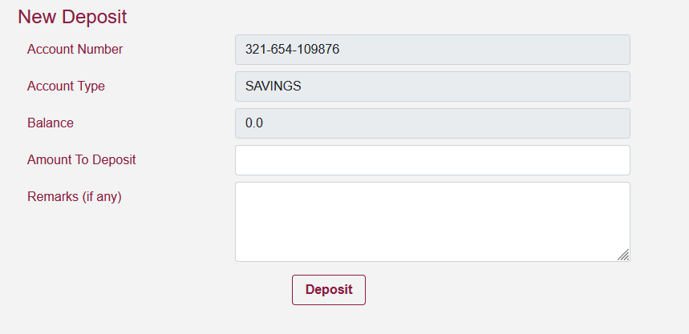
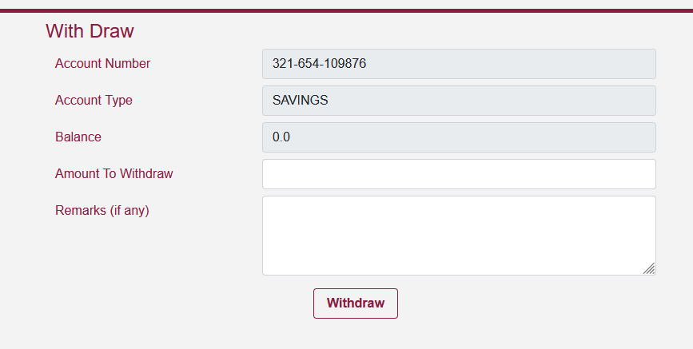
What We learned Employee
Notes:
We minimized the coding by having at least one registration form for the customer and the employee, after registration, the admin assigns the roles and everyone can even have two roles, employee and user, and the roles are separated by a comma. split

Slide 17
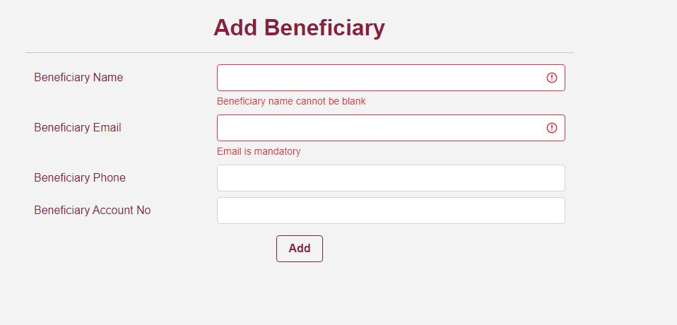
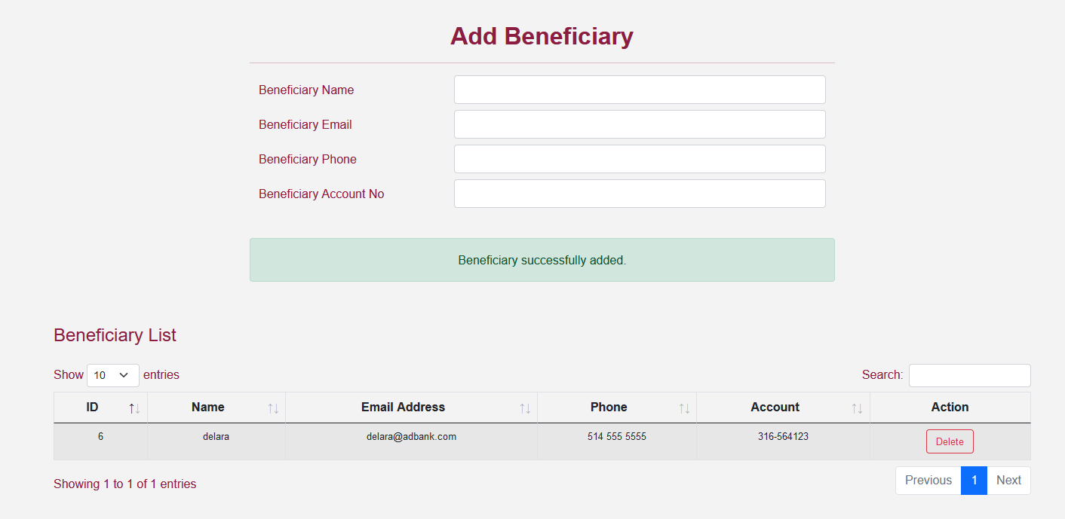
What We learned
Displaying Error Messages with Thymeleaf in Spring
<div th:if="${errorMsg}"><p class="alert alert-danger mt-2 text-center">[[${errorMsg}]]</p></div>
<div th:if="${successMsg}"><p class="alert alert-success text-center">[[${successMsg}]] <br>[[${activateMsg}]]</p></div>
Notes:
Thymeleaf is a popular server-side template engine for Java-based web applications. It provides a powerful and flexible way to create dynamic HTML pages by allowing you to embed dynamic content and expressions within your HTML code. Thymeleaf also includes support for displaying error messages, which can be very useful when working with form validation.

Slide 18
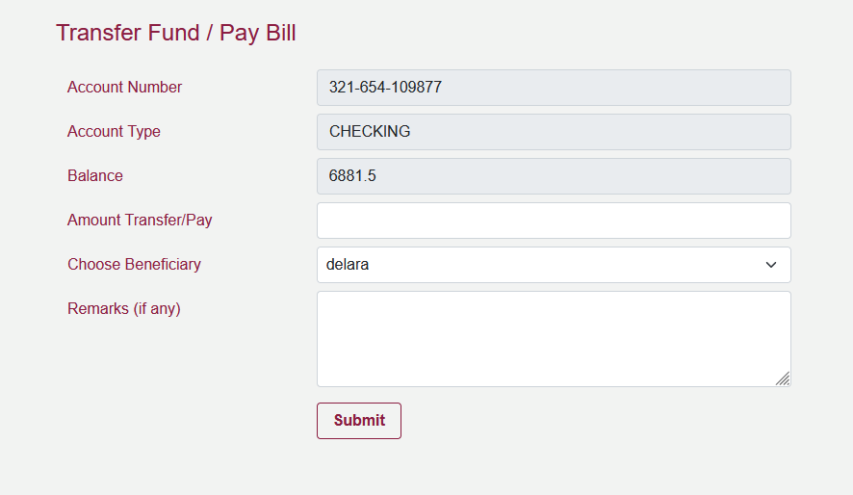
Notes:
This form is a good example of expressing the correct and effective relationship among all four tables in the entire database.

Slide 19
Future work
Ability to download and print history.
Enable SMS.
Password recovery.
E-Transfer.
Send statement to email address every month.
Download and print statements.
GPS login.
Transfer with phone number.
Notes:
Save login location

Slide 20

Summary
Given the limited timeframe and the volume of information at our disposal, we made a concerted effort to maximize team collaboration by effectively managing our time and taking into account the unique skills and abilities of each team member. Despite the challenges we faced, we remained committed to working together towards our shared goals and achieving success as a cohesive unit.
Notes:
In the short period of time we had, with the amount of information we got, we tried our best to have a maximum team role by managing time and considering individual abilities.
In this project, we collaborated on all parts, I worked more on the backend and Arjan worked on the frontend

Slide 21


Thank You
DELARA AMIRI
Arjun Dhakal
delara.vandani@johnabbottcollege.net
6213593@johnabbottcollege.net
https://ad-bank-management.herokuapp.com/
Notes:
Thank you for your attention

